Slide 1


Lecture 1: The Blockchain technology
[Mario Mureddu,
University ofCagliari] 13/09/2021 Cagliari, Italy

Slide 2







Course material developed in collaboration with University of Cagliari, University of Cyprus, University of Western Macedonia, Mines ParisTech, Technische Hochschule Ulm, Deloitte, WIP with support from Erasmus+

Slide 3
Content Structure
Time: Full course length is 20 hours:
10 Hours held by Dr. Mario Mureddu
10 hours held by Dr. Matteo Troncia
5 lectures:
The Blockchain technology (3 h - Mureddu)
Technical functionalities (5 h - Mureddu)
Discussion on the Blockchain advantages, drawbacks, and current technological limitations (4 h – 2h Mureddu, 2h Troncia)
Blockchain and electricity sector, how this technology fits with the ongoing transition (4h - Troncia)
Blockchain-based business models for the power system (4h – Troncia)
3 tutorials (will be part of the lectures):
Hashing technology and its applications in python
Interaction with the Ethereum blockchain
Creation and interaction with an Ethereum smart contract

Slide 4
Goals of the first part of this course
Ideally, by following the first three lessons of this course you will learn:
Why the concept of blockchain has been devised and what are its advantages and drawbacks;
Basic pills of cryptography for surviving in the modern world
How the Ethereum Blockchain platform works and how to interact with it
Some basics on smart contract construction and interaction.

Slide 5
What you should learn from this lesson
Decentralization vs centralization: advantages and drawbacks of both approaches
What is a Blockchain and how it works (long story short)
What is a Blockchain and how it works (in details, so the long story)
What cryptographic hash functions are, how they work, and why they are so important in the modern world

Slide 6
Content of the lecture
Introduction
The original question: is it possible to decentralize the concept of money?
Blockchain as a decentralization technology
Basics of cryptography: hashing (with tutorial)

Slide 7
Centralization vs decentralization
‘’[…] there are three politeiae (forms of government): monarchy, oligarchy, and democracy […] they appear to be the most typical forms […] Of these forms of government, which have achieved the widest and greatest power in their periods of dominion, the Persians received as their lot royalty absolute and irresponsible, the Spartans oligarchy aristocratic and uncontrolled, the Athenians democracy self-governing and undiluted. When these forms are not hit exactly, their perversions and exaggerations are what are called tyranny, the predominance of great families, or mob-rule: that is, when royalty breeds violence and irresponsible action; oligarchy, arrogance and presumptuousness; democracy breeds anarchy, equality, excess, and all of them folly.’’
Plutarch. Moralia, On Monarchy, Democracy, and Oligarchy (around 100 AD)

Slide 8
Centralization vs decentralization
Since when the concepts of centralization and decentralization were still not formalized, humanity struggled to identify optimal ways to manage the interaction between people (and, in modern times, machines).
In politics
In administration
In the management of foundamental resources (someone said energy?)
And, in the current information era, in information technology

Slide 9
Centralization: great to achieve efficiency (for not so complex societies)
Pros:
Allows for fastly decision making
Defines clear and easily accessible supply and decision chains
Permits the full coordination between the performed actions (Uniformity)
Cons:
It is inherently fragile -> if central management falls, it come anarchy;
The central management must take care of all the decision process -> it needs to have great ‘’computational capabilities’’ to cope with it
Distance, time delays and lack of communication lines between decision makers and decision takers can bring to destruction
Highly susceptible to corruption: if central management behaves arbitrarily, the system falls.

Slide 10
Decentralization: scalable and highly resistant to attacks, but hard to achieve consensus
Pros:
Everyone is able to make decisions, and to perform complex tasks, possibly teaming with others;
Highly resistant to attacks and failures of single elements (corruption)
Decision processes are distributed, and can be performed by a lot of’’slow thinking’’ entities.
Cons:
Systemic decision processes are subject to time consuming and costly consensus processes
It is hard to achieve uniform behavior between the parts of the system (which is not always negative)
Hard to identify trusted parties for performing complex tasks which involve multiple entities
It duplicates work (why repeatedly make costly decisions on periphery that can be made once and for all bya central authority?)

Slide 11
Questions
Which processes works better when centralized?
Which processes works better when decentralized?
What are the technical limitations which can undermine a centralized system?
What are the technical limitations which can undermine a decentralized system?
Your questions?

Slide 12
Centralization vs decentralization in ICT
Centralized servers and communications (master-slave architecture):
Central server performs calculations and make decisions
After receiving all the needed information from slave devices
It is clear and easy to identify the trusted party and follow its instructions
If central server fails (or its communication device fails), slave devices become useless
?
?
?
?
?
?

Slide 13
Centralization vs decentralization in ICT
Decentralized servers and communications (Peer to Peer (P2P) architecture):
All devices perform calculations and interact when needed
Each device can perform partial calculation with partial access to information (potentially suboptimal!)
It could be very difficult to prove that a certain information is coming from a trusted device (need for digital signature)
If one or more peers server fail (or their communication devices fails), network can still work
!
!
!
!
!

Slide 14
The dream of Satoshi Nakamoto: a decentralized digital banking
Durable
Portable
Divisible
Uniform/Fungible (Crawfurd v. Royal Bank 1749)
Acceptable
Stable
Limited supply
Hard to Counterfeit
Bank 1
Bank 2

Slide 15
The dream of Satoshi Nakamoto: a P2P digital banking
Needs to ensure the same characteristics of money, and to substitute banks:
Trust
Integrity
Double spending resistence
Finiteness of money

Slide 16
The dream of Satoshi Nakamoto: Bitcoin
A ledger, accessible to everyone, were ALL the money transactions can be stored
At any time, it is possible for everyone to know the amount of money everyone has, and decide if he can pay for a good or a service
And, once the payment is done, be sure that the money has correctly been sent and that money willl be of the receiver until it will decide to reuse it.
Also, I want to be sure that I and only I can send my money to whom I decide.

Slide 17
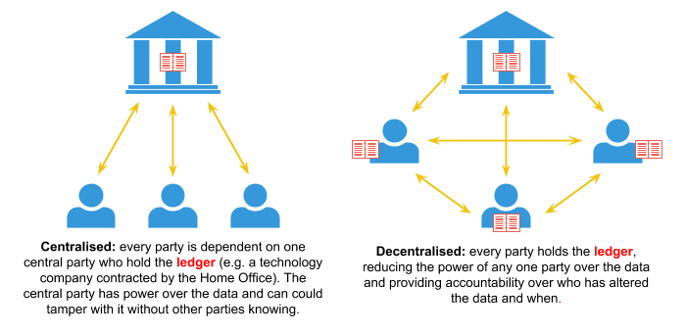
Decentralized ledger technologies

Slide 18
Questions
Your questions?

Slide 19
Decentralized ledger: how can we achieve it?
Satoshi Nakamoto combined 3 technologies:
P2P technology (torrents)
Cryptographical hashing
Digital signature
Defining the Blockchain concept and the Proof of Work (PoW) methodology as its consistency condition

Slide 20
Blockchain: how to build a cryptographically secure distributed ledger.
Nakamoto faced the following issue: how can we give everyone (willing to have it) a copy of a ledger which:
Does not rely on central authorities for guaranteeing its content
It is the same among all the participants, so that:
it is possible to follow all the history of all the transactions -> know everyone balance
it is impossible to spend the same money twice
Every transaction contained in it is immutable:
The ledger cannot be (or is very hard to be) modified by malicious attacks
Available to potentially everyone with a computer and an internet connection
Is capable of ensuring a precise chronological consequency between transactions

Slide 21
The Blockchain: how to construct a decentralized ledger
A sent x to B
C sent y to Z
…..
…..
…..
…..
…..
…..
…..
…..
If A wants to sent money to B, it should have enough balance to do it
And it has to prove that he is really A
It should be extremely diffilcult to modify pages
Whoever spreads each page must be entitled to do it
Each page n should somehow linked to pages n – 1, n – 2, …, 1. In this way it is not easy to change page n – m without updating also the following m ones (causality linked)
Given what happened in page 1, which set the balance of A to ..., of B to …. etc., the transactions in this page are:
T sent x to M
Z sent y to G
…..
…..
Signed:
The trusted party
Signed:
The trusted party
Page 1
Page 2

Slide 22
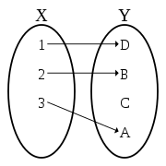
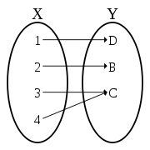
Proof of existence: the hashing function
Suppose we have an injective function H(x), easy to compute, which maps every message to another one of fixe lenght
Suppose that it is neither surjective or invertible
Some random information x
h = H(x)
X
If the only way to know that a certain number h is calculating H(x), then you can only have H(x) if you have x
If you can prove you have H(x), you can also delay the prove you have x
If H(x) can map any arbitrary x to a fixed lenght information, then you can prove you have a very lengthy x without having to communicate x (you can always send h)
H(x) somehow is the ‘’cryptographically signature’’ of x: I am x, my H(x) is h, and you can know it only if you know x
Injective
Surjective

Slide 23
The Blockchain: Hash function as enabling technology
A sent x to B
C sent y to Z
…..
…..
…..
…..
…..
…..
…..
…..
Whoever spreads each page must be entitled to do it
Each page n should somehow linked to pages n – 1, n – 2, …, 1. In this way it is not easy to change page n – m without updating also the following m ones (causality linked)
It should be extremely diffilcult to modify pages
If A wants to sent money to B, it should have enough balance to do it
And it has to prove that he is really A
H(page 1)
T sent x to M
Z sent y to G
…..
…..
Signed:
The trusted party
Signed:
The trusted party
Page 1
Page 2

Slide 24
Questions
Your questions?

Slide 25
Proof of Work: let’s make hashing artificially difficult
H(x)
f9fa8787
x = 334b7687c876786d7687e7664564a57657f
(Calculated by CRC32)
Append a generic number N to x, calculate H(N|x). Can you find a number N for which H(N|x) is < then M = 01000000? (I just did it, it is 7!)
I was lucky, only one number every 256 have this property! (16*16)
The smaller M, the less probability we have to find a number N for which (H(N|x) < M → making M small makes hashing artificially difficult!
H(N|x)
x = 334b7687c876786d7687e7664564a57657f
00f17d6e
N = 7
(Calculated by CRC32)

Slide 26
Proof of Work: let’s make hashing artificially difficult
Page 1
Going forward is hard, bu still doable.
But if we want to maliciously change page 1, H1 will change
Since H2 contains H1, also H2 will change
And since H3 contains H2, also H3 will change and so on.
Changing a page (block) in teh past requires vey high computational power since we need to recompute the (artificially difficult) hashes between the block we want to change and the last one.
x = 334b7687c876786d7687e7664564a57657f
H(N|x)
H1 = 00f17d6e
N = 7
(Calculated by CRC32)
Page 2
x = 4f5603bf943f433d230dde28a82dc389
H(N|H1|x)
H2 = 006c24d1
N = 47
(Calculated by CRC32)
Page 3
x = afb487f12ecb9d420f8b2a435c0b4563
H(N|H2|x)
H3 = 0089ebe5
N = 3011
(Calculated by CRC32)

Slide 27
The Blockchain: Proof of Work for securing blocks
A sent x to B
C sent y to Z
…..
…..
…..
…..
…..
…..
…..
…..
Whoever spreads each page must be entitled to do it
Each page n should somehow linked to pages n – 1, n – 2, …, 1. In this way it is not easy to change page n – m without updating also the following m ones (causality linked)
It should be extremely diffilcult to modify pages (if M is mall enough, it can take years to calculate, we’ll se later how much)
If A wants to sent money to B, it should have enough balance to do it
And it has to prove that he is really A
H(N|page 1)
N by which H(N|Page 1) < M
T sent x to M
Z sent y to G
…..
…..
Signed:
The trusted party
Signed:
The trusted party
Page 1
Page 2

Slide 28
Questions
Your questions?

Slide 29
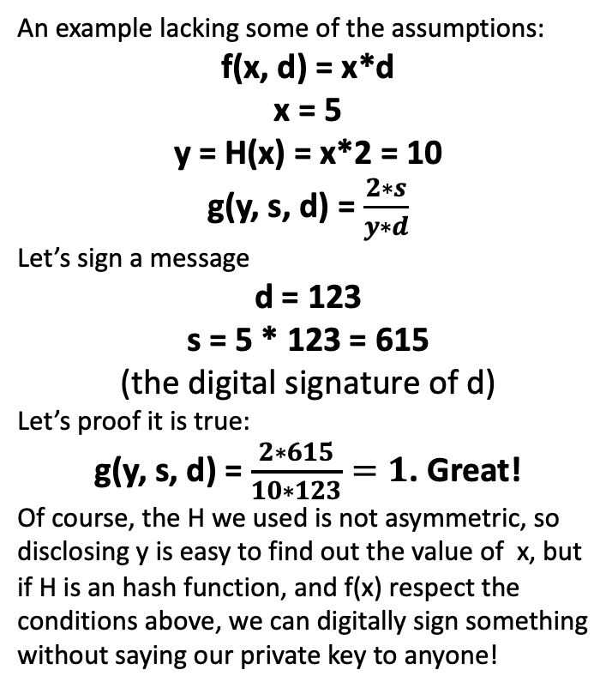
Digital signature
An example lacking some of the assumptions:
f(x, d) = x*d
x = 5
y = H(x) = x*2 = 10
g(y, s, d) = $\frac{2∗s}{y∗d}$
Let’s sign a message
d = 123
s = 5 * 123 = 615
(the digital signature of d)
Let’s proof it is true:
g(y, s, d) = $\frac{2∗615}{10∗123}=1$. Great!
Of course, the H we used is not asymmetric, so disclosing y is easy to find out the value of x, but if H is an hash function, and f(x) respect the conditions above, we can digitally sign something without saying our private key to anyone!
How can I prove I am the emitter of a certain electronic document?
Suppose we have:
A digital document d
A private key x
A public key y (mathematically linked to x through an asymmetric function H, so that with x you can calculate y, but you cannot di the opposite)
If a function s = f(x, d) exists, so that g(y, s, d) = 1, whoever knows y (but not x), d and s can check if it has been calculated with x
So I can sign everything with my x, disclose y and let everyone know I signed it with x (without making my x public)

Slide 30
The Blockchain: digitally signature as a proof of identity
A sent x to B, signing it. I checked it with its public key y.
C sent y to Z, signing it. I checked it with its public key y.
…..
…..
…..
…..
…..
…..
…..
…..
Whoever spreads each page must be entitled to do it
Each page n should somehow linked to pages n – 1, n – 2, …, 1. In this way it is not easy to change page n – m without updating also the following m ones (causality linked)
It should be extremely diffilcult to modify pages (if M is mall enough, it can take years to calculate, we’ll se later how much)
If A wants to sent money to B, it should have enough balance to do it
And it has to prove that he is really A
H(N|page 1)
N by which H(N|Page 1) < M
T sent x to M, signing it. I checked it with its public key y.
Z sent y to G, signing it. I checked it with its public key y.
…..
…..
Signed:
The trusted party
Signed:
The trusted party
Page 1
Page 2

Slide 31
Questions
Your questions?

Slide 32
Who can create new ’’pages’’ of the ledger?
If old pages are ’’written in stone’’ since a very hard hashing procedure occurred (and blocks are related between them by hashing)
If everyone that sends a transaction can be univoquely identified through its signature
If we can then access to the entire system history, being sure it is immutable
If hashing, the only thing we need, can be easily claculated by each computer in the world (and it will return the same value everywhere)
Why do we need a third party authority which should emit these blocks?

Slide 33
The blockchain: a distributed ledger
Decentralized servers and communications (Peer to Peer (P2P) architecture):
Peers exchange information among them (the pages existing and validated since now)
Whoever wants can send a transaction (digitally signed) to the system
The nodes verify it and add it to a pool
And all of them starts to calculate the hash of the new block (which contains all the newly validated transactions)
When someone finds this hash, it broadcast it, adding a new page!

Slide 34
The Blockchain: No need of a central authority
A sent x to B, signing it. I checked it with its public key y.
C sent y to Z, signing it. I checked it with its public key y.
…..
…..
…..
…..
…..
…..
…..
…..
Whoever spreads each page must be entitled to do it
Each page n should somehow linked to pages n – 1, n – 2, …, 1. In this way it is not easy to change page n – m without updating also the following m ones (causality linked)
It should be extremely diffilcult to modify pages (if M is mall enough, it can take years to calculate, we’ll se later how much)
If A wants to sent money to B, it should have enough balance to do it
And it has to prove that he is really A
H(N|page 1)
N by which H(N|Page 1) < M
T sent x to M, signing it. I checked it with its public key y.
Z sent y to G, signing it. I checked it with its public key y.
…..
…..
Signed:
The trusted party
Signed:
The trusted party
Page 1
Page 2

Slide 35
The blockchain: resistant to attack
Decentralized servers and communications (Peer to Peer (P2P) architecture):
If a node falls, others can continue the process
If the node comes up again, he can just download the last blocks and start to work again
If he did not lost its private key, he can still sign transacitons and dispose of its money (or, in general, write informations in the ledger)

Slide 36
Questions
Your questions?

Slide 37
Only money?
Think about it: do we only have to insert information about exchanges of money in our brand new distributed ledger? We can:
Write an entire project
A certificate of ownership
A criptographed certificate of ownership (just publish the hash)
A bid to an auction, without need to have a third party holder for the auction
Save the instructions of a virtual machine able to make computations! (This will be aprt of next lesson/exercise)
Other: open to everyone!

Slide 38
Exercise: Cryptographic Hash Functions
We’ll move to jupyter notebook for exercises on the hashing functions, plan is:
To show how you can interact with hash functions with python
Demonstrate some of their properties
And potential uses

Slide 39
Exercise: Cryptographic Hash Functions
Cryptographic Hash Functions Digital Fingerprints for Data
Maps Input x of any size to an Output of fixed size – called a ‘Hash’
Deterministic: Always the same Hash for the same x
Efficiently computed
Cryptographic Properties
Preimage resistant (One way): infeasible to determine x from Hash(x)
Collision resistant: infeasible to find and x and y where Hash(x) = Hash(y)
Avalanche effect: Change x slightly and Hash(x) changes significantly
Puzzle friendliness: knowing Hash(x) and part of x it is still very hard to find rest of x

Slide 40
Questions
Your questions?

Slide 41
Thank you for your attention!
www.smartgridsmaster.eu

